Slide 1
Bank Marketing
Krishna Teja Grandhi

Slide 2
Problem Statement
Analyze the last marketing campaign the bank performed and identify the patterns that will help finding conclusions in order to develop future strategies.

Slide 3

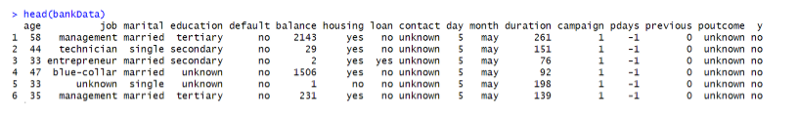

About the dataset..
45K records with 17 features.
Information about the customer along with previous campaign results.

Slide 4

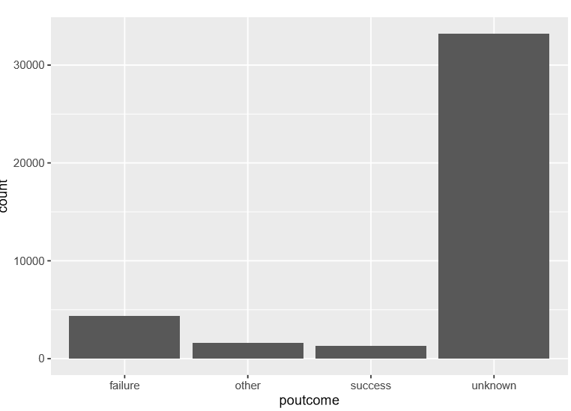
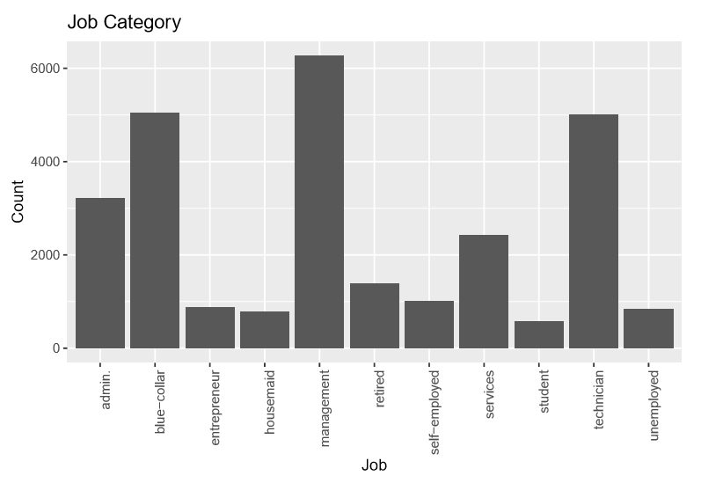


Preprocessing and EDA
Outliers and missing values.
Understanding data.

Slide 5
PCA and selection.
Capture variance between the features.

Slide 6
Machine learning models
Models
SVM
Random forest
Knn
Hyper parameter tuning
Training
Metrics

Slide 7
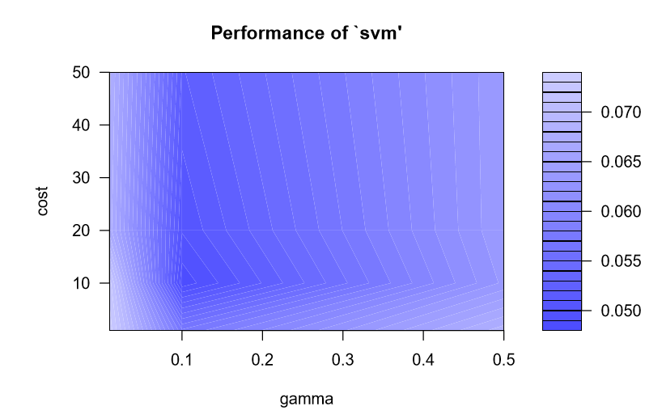
SVM
Hyper parameter tuning
Cost : 10
Gamma :0.1
Radial kernel
Metrics
Recall : 61
Accuracy: 83.9

Slide 8
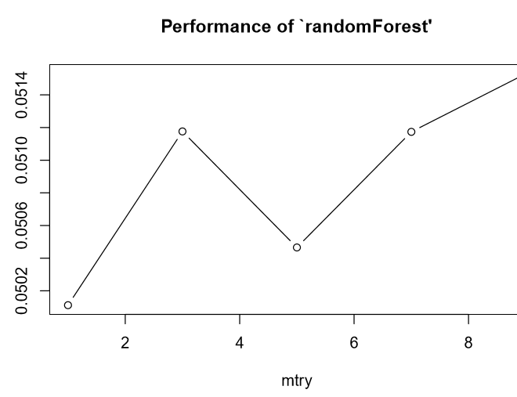
Random Forest
Hyper parameter tuning
mtry : 5
Metrics
Recall : 72
Accuracy: 84.8

Slide 9
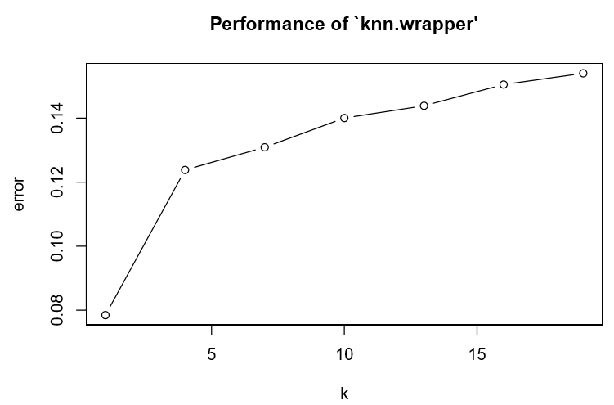
KNN
Hyper parameter tuning
K : 7
Metrics
Recall : 74.4
Accuracy: 85.13

Slide 10
Conclusion
Why recall?
Best model – KNN

Slide 11
Thank You!

